Slide 1
MONO/MULTI SPLIT SYSTEM
AND SPLIT HEAT PUMP FOR HOUSE WITH DHW MANAGEMENT

Slide 2
System outdoor units
AEI1G30EMX
AEI1G50EMX
^{AEI1G65EMX}
^{AEI1G65EMX3PH}
^{AEI1G80BEMX}
^{AEI1G80EMX3PH}
^{AEI1G110BEMX}
^{AEI1G110EMX3PH}
^{AEI1G140MX}
^{AEI1G140 EMX}
^{Energy class A+}
^{Energy class A+}
^{Energy class A+}
^{Energy class A+}
^{Energy class A+}
^{Energy class A+}

Slide 3
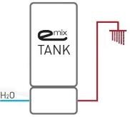
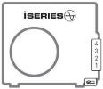
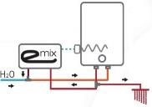
A2A – A2W Full Dc Inverter Heat pump – SPLIT
What makes iSERIES unique is the possibility to use, with the same outdoor unit, hydronic and/or direct expansion indoor units, producing DHW by heat recovery in the same time (in cooling mode).
MULTISPLIT SYSTEM WITH DHW PRODUCTION
A2A
HYDRONIC SYSTEM WITH DHW PRODUCTION
A2W

Slide 4
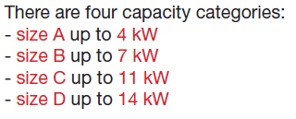
INDOOR UNITS DC

Slide 5
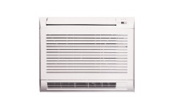
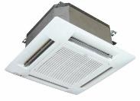
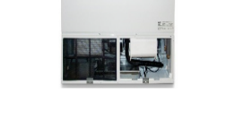
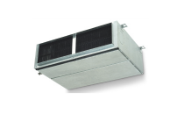
System indoor units
The direct expansion indoor units
AWIAS19
AWIBS19
AWICS 19
Wall
AFIAS11DC
AFIBS11DC
Floor
ASIAS8DC
ASIBS9DC
ASICS11DC
ASIDS13DC
Cassette
SDIAS8
SDIBS9
Ductable low prevalence
ADIAS19
ADIBS13
ADICS10
Ductable medium prevalence

Slide 6
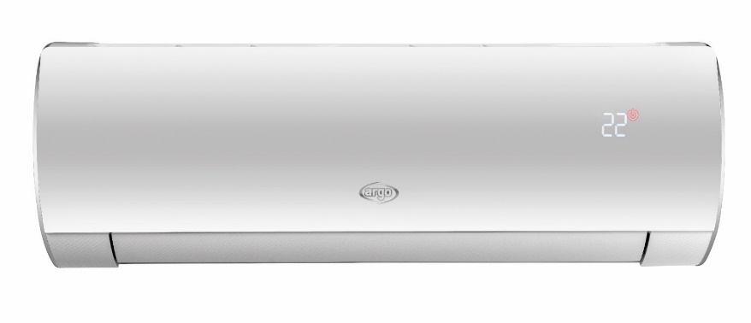
HIGH WALL
A19
AWIAS19
AWIBS19 LOW AMB
AWICS19 LOW AMB

Slide 7
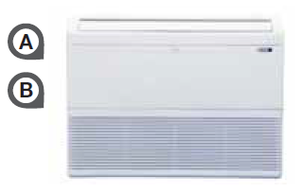
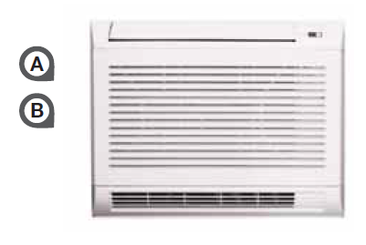
CONSOLES

Slide 8
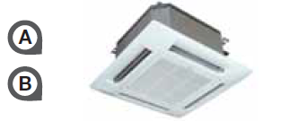
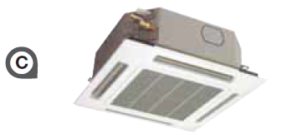
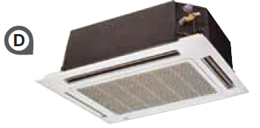
CASSETTES
ASIA8DC
ASIBS9DC
ASICS10DC
ASICS13DC

Slide 9
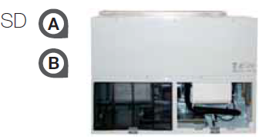
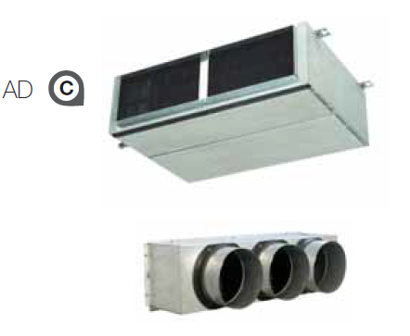
SLIM DUCT
SDIAS8
SDIBS9
ADIAS19DC
PLENUM 2 WAYS
ADIBS13
ADICS10
PLENUM 3 WAYS
SIZE A
SIZE B
SIZE C

Slide 10
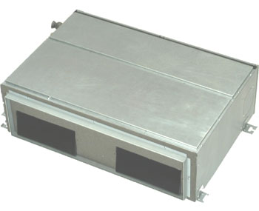
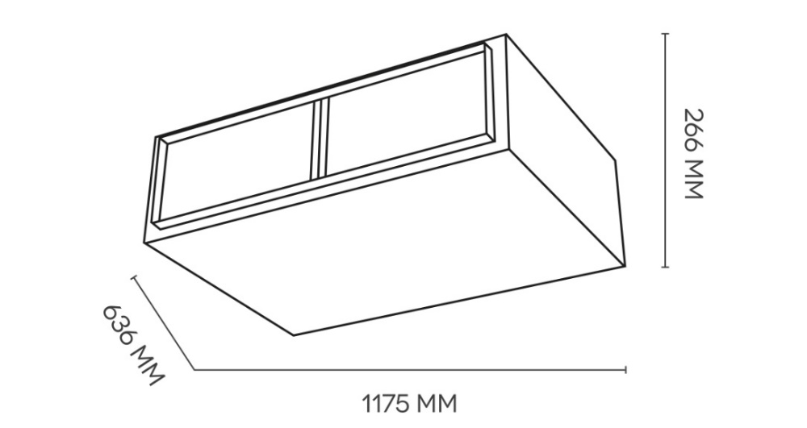
INDOOR UNITS ISERIES
SLIM DUCTED ADIAS19DC – SIZE A
PROFESSIONAL RANGE - NEW DUCTED INDOOR UNITS ISERIES

Slide 11
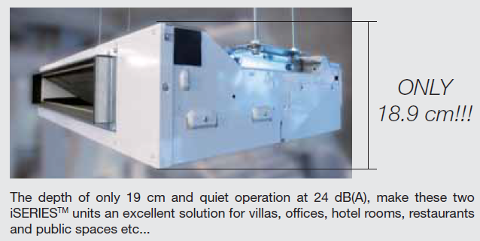
SIZE A
SIZE B

Slide 12
DYNAMIC ACCESORIES

Slide 13
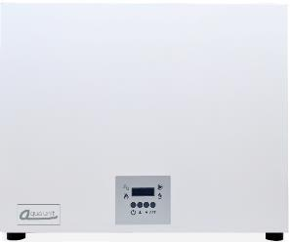
AQUA UNIT
The hydronic indoor units: AQUA UNIT
4 kW (AUAH - size A) matching with ODU G50 (mono phase)
6,5 kW (AUBH - size B) matching with ODU G65 (mono phase and three phase)
11 kW (AUCH - size C) matching with ODU G80/G110 (mono phase and three phase)
14 kW (AUDH - size D) matching with ODU G140 (three phase unit only, mono phase unit is coming)
387135037 | AUBV V2 - AQUA UNIT B VERT. PAN. REMOTO | phase in
387135038 | AUCV V2 - AQUA UNIT C VERT. PAN. REMOTO | on line
387135039 | AUDV V2 - AQUA UNIT D VERT. PAN. REMOTO | on line
387030220 | WIRED CONTROLLER FOR ISERIES | on line

Slide 14
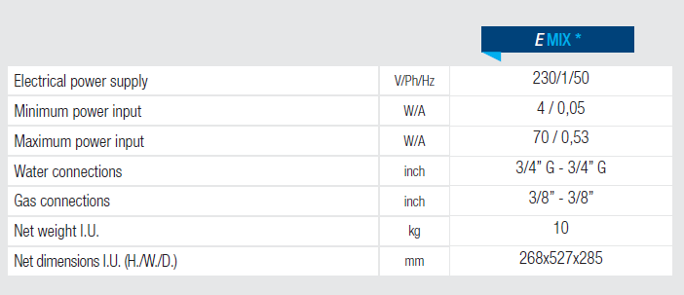
How to produce DHW – Partial heat recovery : eMIX AND eMIX TANK
eMix & eMix tank have the same function: DHW production
eMix is a stand-alone unit that must operate with a tank (available at least 80 liters)
eMix tank is supplied instead of a tank, all in a specific chassis. Two models are available: with 200 and 300 liter tanks.
Emix V1
eMIX tank
200&300L
200L
300L

Slide 15
ACCESSORIES
387030705 | TANK 45LT
387030706 | TANK 85LT
387030213 | CONDENSING TRAY
387030214 | REMOTE PANEL FOR HYDRONIC UNITS
387030215 | IMODBUS GATEWAY WIFI
387030701 | ACS 200 LT - 1S BV
387030702 | ACS 300 LT - 1S BV
387030700 | ACS 300 LT - 2S BV
387030208 | ELECTRICAL HEATING 3 KW- TANK 300 LT
387030209 | 3-WAY VALVE
387030210 | BIDIRECTIONAL SERVO MOTOR
387030211 | DHW CONTROL PANEL
387030665 | TEMP. SENSOR FOR DHW 6 MM
387030727 | ADDITIONAL ELECTR. HEAT. INTERNAL INST. 3KW 1-PH
387030728 | ADDITIONAL ELECTR. HEAT. INTERNAL INST. 3KW 3-PH
TANKS
& ACCESORIES
BUILT IN SOLUTION
387030730 | BUILT IN BOARD
387030731 | DHW 200 LT TANK (WITH EXCHANGER)
387030732 | AQUA UNIT CONNECTION KIT
387030626 | BUILT IN EMIX BOARD 1000X415X2242
387030627 | DHW 200 LT TANK (W/O EXCHANGER)
387030628 | EMIX HYDRAULIC CONNECTION KIT
387030629 | EMIX AND AQUA UNIT HYDRAULIC CONNECTION KIT
387030630 | SANITARY COLD WATER FILTER
387030631 | 3/4" SHUT-OFF VALVE KIT
387030632 | ELECTRICAL HEATING 1,5 KW FOR DHW TANK

Slide 16
TARGET APPLICATIONS

Slide 17
APPLICATION WITH EMIX

Slide 18
APPLICATION WITH TANK

Slide 19
APPLICATION WITH BOILER

Slide 20
APPLICATION WITH SOLAR

